Slide 1
Perinatal Hepatitis B Case Management 2022
Mary Stanley, RN
Candy Graham, RN
NC Immunization Branch

Slide 2
What is hepatitis B?
Liver infection caused by the hepatitis B virus (HBV)
May cause acute or chronic hepatitis
Many chronically infected persons are asymptomatic.
HBV is resilient and can remain infectious on surfaces for more than 7 days at room temperature
HBV prevalence rates vary greatly throughout the world.
Notes:
Once infected with the hepatitis B virus there are three possible outcomes.
Fulminant liver failure is the most severe form of acute hepatitis b which causes extensive liver cell necrosis resulting in liver failure and sometimes death. Thankfully, this form of acute hepatitis b is uncommon, occurring in only 1% of acute hepatitis b cases.
The HBV is spontaneously cleared from the body within a few months and immunity develops.
3. Failure to clear the initial HBV infection resulting in lifelong chronic infection.
**The risk for chronic infection varies according to the age at infection and is greatest among young children. Approximately 90% of infants and 25%–50% of children aged 1–5 years will remain chronically infected with HBV. By contrast, approximately 95% of adults recover completely from HBV infection and do not become chronically infected (11). (https://www.cdc.gov/hepatitis/hbv/hbvfaq.htm#overview)

Slide 3
How is Hep B Spread?
Birth (spread from an infected mother to her baby during birth)
Sex with an infected partner
Sharing needles, syringes, or other drug-injection equipment
Sharing items such as razors, toothbrushes or glucose monitoring devices with an infected person
Direct contact with the blood or open sores of an infected person
Exposure to blood from needlesticks or other sharp instruments
It can survive outside the body for 7 days
HBV is not spread through food or water, sharing eating utensils, breastfeeding, hugging, kissing, hand holding, coughing, or sneezing.
Notes:
**if the nipples are bleeding with breastfeeding there is a possibility of exposure

Slide 4
Outcomes of Hep B After Infection
Once infected with the hepatitis B virus there are three possible outcomes.
1. Fulminant liver failure is the most severe form of acute hepatitis b which causes extensive liver cell necrosis resulting in liver failure and sometimes death. Thankfully, this form of acute hepatitis b is uncommon, occurring in only 1% of acute hepatitis b cases.
2. The HBV is spontaneously cleared from the body within a few months and immunity develops.
3. Failure to clear the initial HBV infection resulting in lifelong infection. 6 to 10% of infected adults will develop chronic infection. Without appropriate medical management, 1 in 4 chronically infected persons will die from cirrhosis, liver failure, or liver cancer.

Slide 5
What is perinatal Hepatitis B? https://www.cdc.gov/hepatitis/hbv/perinatalxmtn.htm#section1
Vertical (mother to child) transmission
Without post-exposure immunoprophylaxis, approximately 40% of infants born to HBV-infected mothers in the US will develop chronic HBV infection
Approximately one fourth of that 40% will eventually die from chronic liver disease

Slide 6
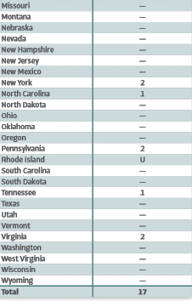
CDC 2019 Number of Newly Reported Cases of Perinatal Hep B Infection https://www.cdc.gov/hepatitis/statistics/2019surveillance/pdfs/2019HepSurveillanceRpt.pdf
Notes:
This is Table 2.4 is the Viral Hepatitis Surveillance Report for 2019. During 2019, a total of 10states reported 17 cases of perinatal hepatitis B that met the classification criteria fora confirmed case. California had the highest number of newly reported cases of perinatal hepatitis B (n = 4)during 2019. Of note, not all perinatal cases reported to National Notifiable Diseases Surveillance System are case managed by the Perinatal Hepatitis B Prevention Program. —: No reported cases. The reporting jurisdiction did not submit any cases to CDC. U: Unavailable. The data were unavailable.

Slide 7
Supplemental Perinatal Hep B Report Data for 1-1-2018 through 12-31-2019 https://www.cdc.gov/hepatitis/statistics/2019surveillance/perinatal-hepb-report.htm

Slide 8
National Guidelines for Preventing Perinatal HBV Transmission https://www.cdc.gov/hepatitis/hbv/perinatalxmtn.htm#section1
Universal screening of pregnant persons for HBsAg during each pregnancy
HBV DNA testing for HBsAg-positive pregnant persons at 26-28 weeks to guide the use of maternal antiviral therapy during pregnancy. AASLD (American Association for the Study of Liver Disease) suggests maternal antiviral therapy when HBV DNA is >200,000 IU/mL
Case management of HBsAg-positive mothers and their infants
Provision of immunoprophylaxis for infants born to infected mothers, including hepatitis B vaccine and hepatitis B immune globulin within 12 hours of birth
Routine vaccination of all infants with the hepatitis B vaccine series, with the first dose administered within 24 hours of birth

Slide 9
Roles within the Perinatal Hepatitis B Prevention Program
LHD
State
CDC
Development of clinical guidelines and recommendations
National reporting
Development of standardized reporting requirements
Oversight of LHD case-management
Statewide reporting to CDC
Education and outreach to LHDs
Partner with LHDs and other state agencies
Direct case-management of infants born to HBsAg(+) women.
Coordination with local hospitals and healthcare providers
Education and prevention
Notes:
This list obviously does not include all partners within the PHBPP. Private providers and birthing hospitals also play a crucial role in preventing perinatally acquired hepatitis b infections.

Slide 10
North Carolina Public Health Law
10A NCAC 41A .0101 REPORTABLE DISEASES AND CONDITIONS
10A NCAC 41A .0102 METHOD OF REPORTING
10A NCAC 41A .0210 DUTIES OF ATTENDING PHYSICIANS
10A NCAC 41A .0203 CONTROL MEASURES ‑ HEPATITIS B
10A NCAC 41A .0101
The following named diseases and conditions are declared to be dangerous to the public health and are hereby made reportable within the time period specified after the disease or condition is reasonably suspected to exist:
(26) hepatitis B - 24 hours;
(27) hepatitis B carriage - 7 days;
Notes:
We cannot give legal advice. This is information for where you can find the law and the general topic in that particular law.
“A local health director may file an action for injunctive relief in a superior court.” (p. 31 Chapter 4 of book NC Communicable Disease Law)
NCAC41A .0101 – this lists all the diseases that are required to be reported to the State and the time frame that they must be reported from when you are made aware.
NCAC41A .0102 – explains how you are to make those reports
NCAC41A .0210 – requirements of physicians regarding control measures and reporting
NCAC41A .0203 – specific requirements for control measures for Hepatitis B and Perinatal Hepatitis B

Slide 11
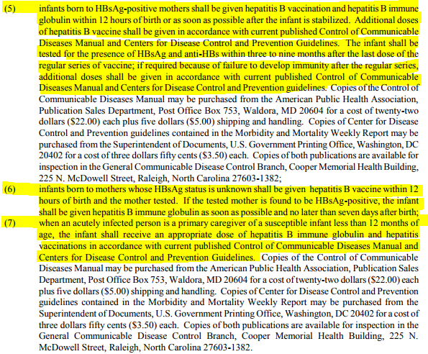
10A NCAC 41A .0203 CONTROL MEASURES HEPATITIS B
(b) The following are the control measures for persons reasonably suspected of being exposed:

Slide 12
Perinatal Hepatitis B Prevention Program Case Management Components for the LHD
Test all pregnant women for HBsAg
Report and track HBsAg (+) women
Provide prenatal HBsAg testing records to delivery hospitals
Identify and manage infants born to HBsAg (+) women
Identify and manage infants born to women without HBsAg test results
Complete the hepatitis b series
Complete post-vaccination serology testing
Manage and evaluate the LHD’s case management program
Notes:
(Intro to the perinatal hep b program)
The perinatal hepatitis B prevention program was initiated to decrease mother-to-child hepatitis B transmission. Infants who become infected with hepatitis B virus have a 90% risk for developing chronic hepatitis B infection and a 25% lifetime risk for dying prematurely from cirrhosis or hepatocellular carcinoma

Slide 13
LHD’s role with local birthing hospitals
Ensure that providers are transmitting HBsAg status results to birthing hospitals prior to delivery.
1
Educate providers on the importance of educating patients on their HBsAg status and ensuring that they communicate this status to the birthing hospital.
2
Work closely with birthing hospitals to implement policies and procedures to ensure identification and initiation of PEP of infants born to HBsAg-positive mothers.
3
Work closely with birthing hospitals to ensure identification and initiation of PEP of infants born to mothers with unknown HBsAg status.
4
Train birthing hospital staff to accurately document the date and time of birth and the date and time of administration for HBIG and Hepatitis B vaccine.
5
Notes:
** if you are new to the role of CD Nurse or PHB Nurse – call your providers and hospitals to introduce yourself to establish a relationship with the L&D nurse and the OB’s assistant.

Slide 14
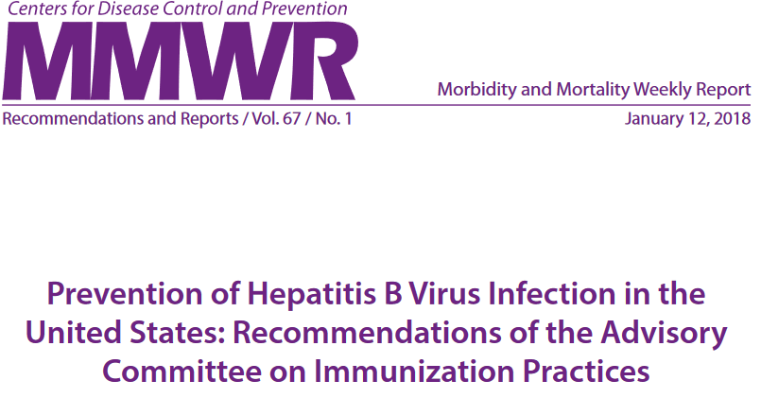
ACIP Recommendations for Infants Born to Hepatitis B Mothers

Slide 15
Case Management of Infants born to women with Unknown HBsAg status
Infants born to women for whom HBsAg testing results during pregnancy are not available but other evidence suggestive of maternal HBV infection exists (e.g., presence of HBV DNA, HBeAg-positive, or mother known to be chronically infected with HBV) should be managed as if born to an HBsAg-positive mother (new recommendation). The infant should receive both HepB vaccine and HBIG within 12 hours of birth
Women admitted for delivery without documentation of HBsAg test results should have blood drawn and tested as soon as possible.
While maternal HBsAg test results are pending, infants with birth weights ≥2,000 grams born to women with an unknown HBsAg status should receive the first dose of HepB vaccine (without HBIG) within 12 hours of birth. Only single-antigen HepB vaccine should be used for the birth dose (administer HBIG only if mother’s HBsAg comes back positive or results are not available within 12 hours)

Slide 16
Mother’s Status Unknown with infants with birth weights ≥2,000 grams Cont.
IF the mother is determined to be positive:
The infant should receive HBIG as soon as possible but no later than age seven days
The vaccine series should be completed according to the recommended schedule for infants born to HBsAg-positive mothers
The final dose in the series should not be administered before age 24 weeks (164 days)
Create a mother and infant event (link together) and send to Perinatal Case management (PCM) for case management
If the mother is determined to be negative:
The vaccine series should be completed according to the recommended schedule for infants born to HBsAg-negative mother
The final dose in the series should not be administered before age 24 weeks (164 days).

Slide 17
If the Mother’s Status Cannot Be Determined Within 12 hours of Birth AND the infant weighs < 2,000 grams:
These infants should receive both single-antigen HepB vaccine and HBIG, administered at different injection sites (e.g., separate limbs)
The birth dose of vaccine should not be counted as part of the 3 doses required to complete the vaccine series;
3 additional doses of vaccine (for a total of 4 doses) should be administered according to a recommended schedule on the basis of the mother’s HBsAg test result.
The final dose in the series should not be administered before age 24 weeks (164 days).

Slide 18
If the Mother’s HBsAg status is Not Determined for Whatever Reason:
Create mother and infant events and follow infant through PCM
The vaccine series should be completed according to a recommended schedule for infants born to HBsAg-positive mothers.
The final dose in the series should not be administered before age 24 weeks (164 days).
These infants should receive postvaccination serologic testing at age 9–12 months, and revaccination if necessary.

Slide 19
Case Management of Infants Born to Known Hep B Positive Women https://www.cdc.gov/mmwr/volumes/67/rr/pdfs/rr6701-H.pdf p. 15
All infants born to HBsAg-positive women should receive HepB vaccine and HBIG within 12 hours of birth, administered at different injection sites (e.g., separate limbs).
The HepB vaccine series should be completed according to the recommended schedule for infants born to HBsAg- positive mothers. SEE CHART BASED ON INFANT’S WEIGHT
Postvaccination serologic testing for anti-HBs and HBsAg should be performed after completion of the vaccine series at age 9–12 months

Slide 20
PEP Guidelines by Maternal HBsAg Status and Infant Birth Weight
Mother HBsAg Status | Infant Birth Weight
 | >2,000g | <2,000g
Negative | Administer Hepatitis B vaccine within 24 hours | Administer Hepatitis B vaccine one month after birth or at hospital discharge
Unknown | Administer Hepatitis B vaccine within 12 hours Draw mother’s blood If mother is HBsAg(+), administer HBIG as soon as possible, but no later than 7 days after birth | Administer Hepatitis B vaccine within 12 hours of birth Draw mother’s blood If results are not received within 12 hours, administer HBIG within 12 hours of birth. *The birth dose does not count towards the series and will need to be repeated at 1 month of age; 4 doses total are needed.
Positive | Administer Hepatitis B vaccine and HBIG within 12 hours of birth | Administer Hepatitis B vaccine and HBIG within 12 hours of birth *The birth dose does not count towards the series and will need to be repeated at 1 month of age; 4 doses total are needed.
Notes:
Updated 3/6/17:
Monovalent Hepatitis B vaccine should be administered within 24h of birth for medically stable infants weighing ≥2,000 grams born to hepatitis B surface antigen (HBsAg)-negative mothers. The recommendations for vaccination of infants <2,000 grams (as well as infants born to HBsAg-positive mothers or mothers whose hepatitis B status is unknown) remain unchanged.
???????Preterm infants weighing <2,000 g born to HBsAg-negative mothers should receive the first dose of vaccine 1 month after birth or at hospital discharge.

Slide 21
3rd Dose Specifics https://www.cdc.gov/mmwr/volumes/67/rr/pdfs/rr6701-H.pdf MMWR January 12,2018

Slide 22
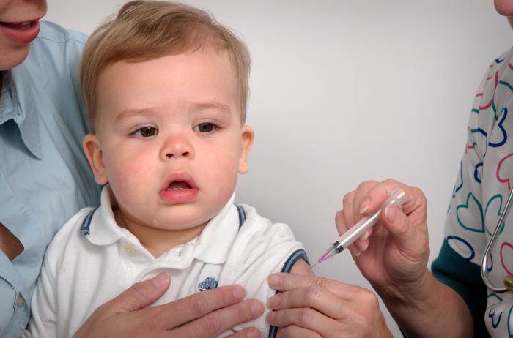
Effectiveness of HBV 3-dose series
HBIG and Hepatitis B vaccine administered within 12-24 hours of birth, followed by completion of a 3-dose Hepatitis B vaccine series is 85-95% effective in preventing acute and chronic HBV infection.
Hepatitis B vaccine series completion (without HBIG and initiated within 12 hours of birth) is 70-95% effective in preventing acute and chronic HBV infection.

Slide 23
Why do we give Hep B vaccine to every child at birth before hospital discharge?
Per ACIP recommendations: For all medically stable infants weighing ≥2,000 grams at birth and born to HBsAg-negative mothers, the first dose of vaccine should be administered within 24 hours of birth
Errors or delays in testing, reporting, and documenting maternal HBsAg status can and do occur, administering the first dose of hepatitis B vaccine soon after birth to all infants acts as a safety net, reducing the risk for perinatal transmission when maternal HBsAg status is either unknown or incorrectly documented at delivery.

Slide 24
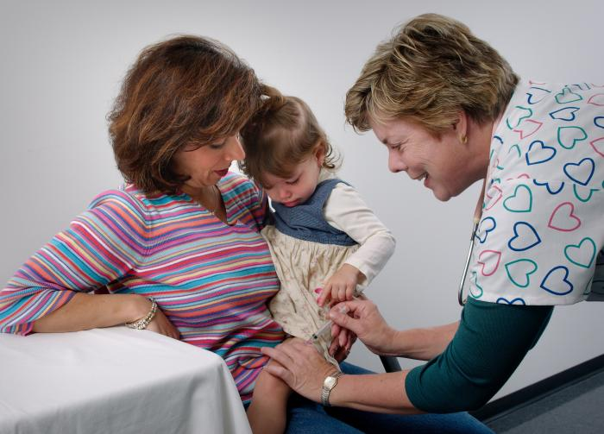
Immune response following Hepatitis B vaccine
Anti-HBs is the only easily measurable correlate of vaccine-induced protection.
Anti-HBs levels ≥10 mIU/mL after vaccination equates to virtually complete lifetime protection from both acute and chronic HBV infection.
Anti-HBs levels decline rapidly in the first year after vaccination, but individuals remain protected even when anti-HBs levels are low or undetectable.
The human body retains immune memory and will develop an anti-HBs response after exposure to HBV.

Slide 25
PVST – Post Vaccination Serology Testing https://www.cdc.gov/mmwr/volumes/67/rr/pdfs/rr6701-H.pdf p. 16 of MMWR
Consists of 2 Tests:
1. HBsAg – Hepatitis B surface Antigen
2. HBsAb – Hepatitis B surface Antibody
***Testing should not be performed before age nine months to avoid detection of passive anti-HBs from HBIG administered at birth and to maximize the likelihood of detecting late HBV infection.
**Anti-HBc testing of infants is not recommended because passively acquired maternal anti-HBc might be detected in infants born to HBsAg-positive mothers up to age 24 months

Slide 26
PVST Results
PVST Should be performed after completion of the Hepatitis B vaccine series at 9-12 months of age*
Should be collected 1-2 months after completion of the Hepatitis B series and no earlier than 9 months of age
Evaluation of results
HBsAg (-) with anti-HBs > 10mIU/mL – immune – no further medical management
HBsAg (-) with anti-HBs < 10mIU/mL – susceptible – revaccinate and retest 1-2 months after the final dose
HBsAg (+) with anti-HBs < 10mlU/mL – infected – refer to specialist for medical management
Revaccination
Infants born to HBsAg-positive mothers. HBsAg-negative infants with anti-HBs <10 mIU/mL should be re-vaccinated with a single dose of HepB vaccine and receive post vaccination serologic testing 1-2 months later. Infants whose anti-HBs remains <10 mIU/mL following single dose revaccination should receive two additional doses of HepB vaccine, followed by PVST 1-2 months after the final dose. Based on clinical circumstances or family preference, HBsAg-negative infants with anti-HBs <10 mIU/mL may instead be revaccinated with a second, complete 3-dose series, followed by post vaccination serologic testing (PVST) performed 1-2 months after the final dose of vaccine.

Slide 28
NC EDSS REPORTING

Slide 29
Identification of HBsAg-positive women and their infants
Electronic Lab feed directly into NC EDSS
Paper lab reporting
Provider reporting
Educate healthcare providers (OB/GYNs, family practitioners, hospitals, etc.) on the importance of testing all pregnant women for HBsAg during each pregnancy and reporting positive results to the LHD and to the selected birth hospital.
Work with delivery hospitals to ensure that protocols are in place to identify infants born to women who are HBsAg (+) or women with unknown HBsAg status. Ensure that they have mechanisms in place to report infant births of HBsAg (+) women and any new positive results to the LHD.

Slide 30
PHB Case Management Guidance
LHD has 30 days from notification to create pregnant woman’s event, do investigation and assign to the State for reporting and case management.
Very important to establish a relationship with the mother as you will be tracking her through her pregnancy and until infant is 9-12 months of age or older if necessary.
Provide Control Measures for mother and infant and document in the Clinical Package.
Even if mother has been reported before, you should review control measures for both mother and infant and document in the event
Have a tracking mechanism for you to track when infant will be delivered based on EDD

Slide 31
Guidance of Case Management Cont.
Pregnancy status should be determined for ALL positive HBV lab results received for women of childbearing age (14-50 years) and documented in NC EDSS.
All HBsAg-positive pregnant women should be entered into case management for tracking of their pregnancy.
Notes:
** this requires some form of tracking system on the part of the LHD. You can use whatever works for you (a paper calendar, a digital calendar, a tickler file with note cards etc)

Slide 32
Case Management Tracking Methods
Variety of ways to track
Notify provider, contact, and index case
Generate a reminder letter or call two weeks before intervention is due.
Any method is acceptable as long as it assures correct and timely follow-up for testing and/or vaccination.
Notes:
There are a variety of ways to track or follow-up with case management of perinatal hepatitis B events.
No matter what system is used the CD nurse must know when and how to notify the provider, contact, or index case as appropriate interventions are due.
All methods should generate a reminder letter or call two weeks before the intervention is due.

Slide 33
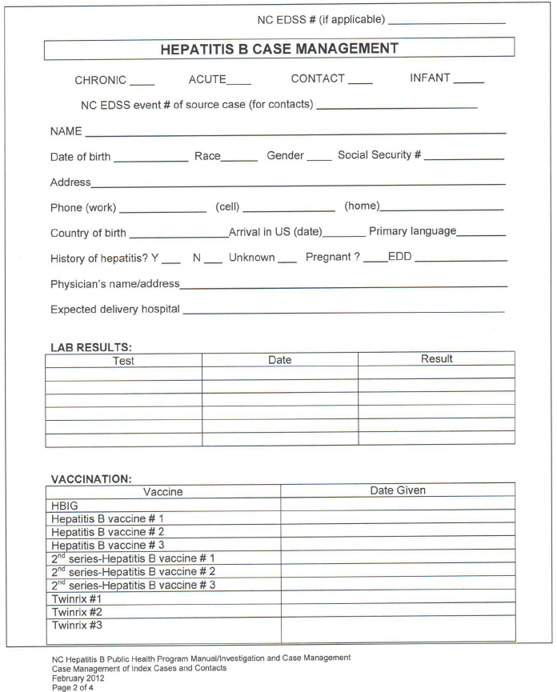
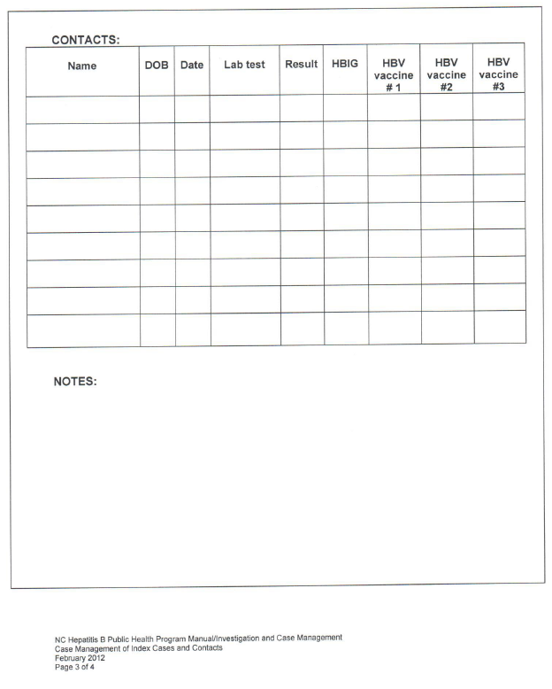
Notes:
This was in the old Hep B manual. We are currently working on an annex to the Hep B Manual specifically for PHB guidance. We will add this to this new annex

Slide 34
Tracking Methods
Case File/Tickler System
One file or sheet for index case and each contact
Can be color-coded
Periodic review is required
Advantage: All information relating to case or contact is on one file/sheet.
Disadvantage: Must review each case on a regular basis to ensure that all cases, contacts, or providers are notified in a timely manner of required interventions.
NC EDSS Task Feature
Provides a method in NC EDSS to track or follow-up the interventions needed.
By creating a task which notes the date an intervention is needed, the CD nurse can assure that interventions are provided at the scheduled dates and times.
Notes:
Case File/Tickler System
Each file can be color-coded according to type (blue for acute/chronic; yellow for contacts; pink for infants, etc). The files can be organized alphabetically, by type (acute, chronic, infants, contacts) and chronologically by the date the intervention is due.
Periodic review is required in order to generate reminder letters and to ensure intervention is completed.

Slide 35
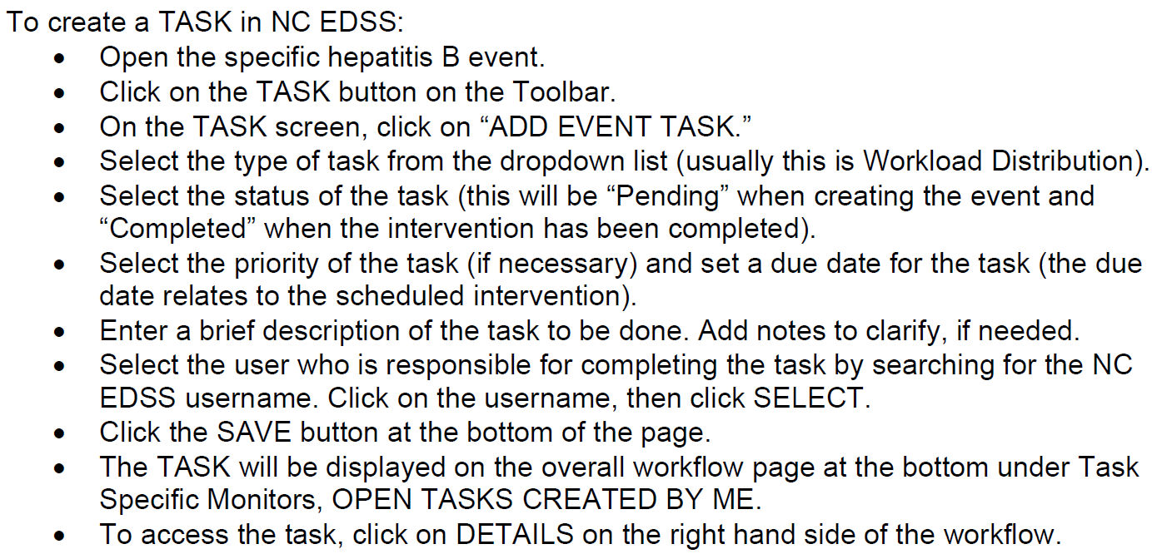
NC EDSS Task Function

Slide 36
HBsAg-Positive Pregnant Woman who Has Not Been Reported Before
LHD has 30 days from notification to investigate and send the event to the State
Investigate to determine if the event is Acute or Chronic
Complete the following packages
Demographic
Clinical
Risk History
Vaccine Information
Assign to the State Registrar to report to CDC; the State Registrar will forward the event to PCM for Case Management
PCM will send back to LHD for tracking until delivery. Submit to PCM when delivered

Slide 37
Lab condition report when a woman has been previously reported
If a woman has been previously reported, the new lab will create a Lab Condition Report Event.
If the woman is pregnant, leave the event as a Lab Condition Report, complete the Subsequent Package Report and send the event to PCM.
Provide Control Measures for mother and infant and document in the Subsequent Package.
Even if mother has been reported before, you should review control measures for both mother and infant and document in the event.
LHD will follow this pregnancy in the Lab Condition Report and when the baby delivers, PCM will send the event to the State Registrar to merge it with the original event.

Slide 38
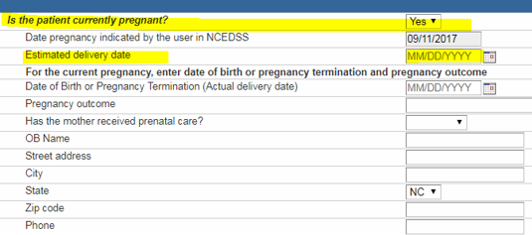
NC EDSS Documentation – Pregnancy Status
Document pregnancy and pregnancy details in the clinical package or Hep B Subsequent Report Package
Once the event is entered into case-management by state PHB, don’t forget to enter insurance information.
Notes:
The insurance status field is not accessible to LHD until event has been submitted to PCM and entered into case management. Prior to initially submitting event to PCM, LHD’s may enter insurance information on dashboard or in administrative package.

Slide 39
Infant’s Event
Create infant’s event, link to mother’s event and assign both events to PCM within 30 days of birth (this is a monitoring requirement)
Complete the following packages:
Demographic
Clinical
Vaccine Information
Document that control measures for the infant were given to the mother in the infant’s event
Hep B vaccine series
PVST completed as CDC recommends
You will follow the infant for at least 9-12 months or until the PVST is complete

Slide 40
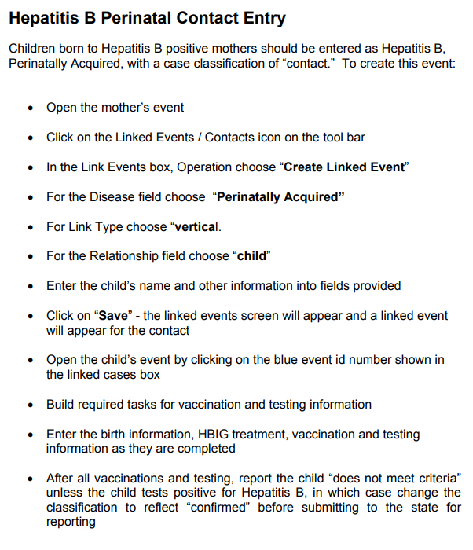
NC EDSS Documentation – Infant Linkage to Mother

Slide 41
NC EDSS Documentation - Infant
Once State PHB has entered the event into case-management, don’t forget to enter the insurance information.

Slide 42
NC EDSS PEP Documentation

Slide 43
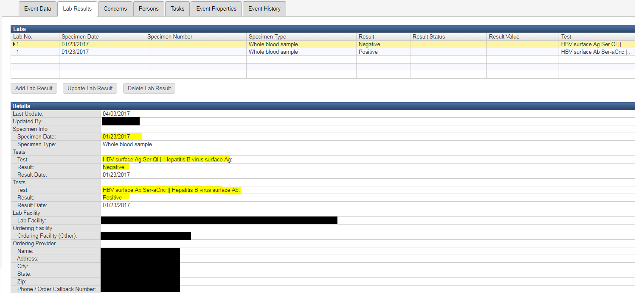
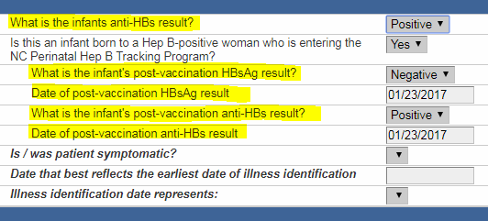
Document lab results in both the lab and clinical packages

Slide 44
Lost to Follow-Up/Family Relocated
Lost to Follow-up
Follow your Policy/Procedure
At least 3 different attempts should be made to contact the family and/or provider and documented on the dashboard of the event
Examples: phone call, letter/certified letter, home visit
Other resources to consider – WIC, Medicaid, NCIR, etc
Family Relocated
Town/city in NC – notify CD nurse and State Perinatal Hepatitis B Coordinator by phone; change county of residence; then LHD – LHD transfer in NC EDSS.
Another state – obtain and document forwarding address and submit to State PCM
Another Country – document which country and submit to State PCM
Notes:
Every attempt should be made to ensure infants born to HBsAg(+) mothers receive PEP, complete the HBV series, and PVST in a timely manner.
Each LHD should have a policy in place to determine what is considered lost to follow-up.
It is very important to get as much information on the forwarding address as possible. Also, contact the last primary care provider in NC to see if they received a request for records to be transferred to another provider.

Slide 45
Parent Non-Compliant with Control Measures
Per the NC Hepatitis B Manual:
It is the responsibility of the Communicable Disease nurse to ensure that control measures have been issued to persons known to be infected with a communicable disease such as hepatitis B. Best practice for issuing control measures would be for the nurse to meet face to face with the client, explain the control measures required by law for hepatitis B infection, review written information with the client about hepatitis B, allow time for the client to ask questions, and then have the client sign a letter which indicates that control measures have been explained (see sample letter in this section). For practical reasons, this cannot always be done. Sometimes it is necessary to issue control measures verbally over the phone to the client or by mailing written control measures and information to the client.
If all attempts have been exhausted, your Health Director may need to consult the local health department’s legal counsel for further guidance.
Document that the health director has been notified on the dashboard of the event and any further steps taken

Slide 46
Perinatal Hep B Monitoring
Monitoring for Perinatal Hep B events are provided at your Immunization Monitoring visit every 2 years (this has to do with your Agreement Addenda requirements and CDC funding for programs)
Work with your Immunization Coordinator to be present at this visit or to get a copy of the report
Monitoring consists of 3 measures discussed on the following slides
LHD’s will receive a written report with details of infants that were case managed during the cohort year and any concerns that were found

Slide 47
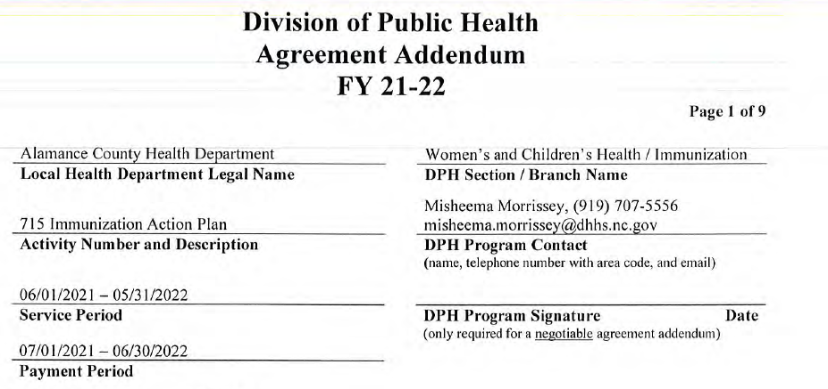
Has the LHD started the investigation to determine if the report is an authentic report i.e. Have they started the Subsequent Package Report if they have been previously reported OR has the LHD changed the classification to Chronic/Acute/or Probable
Measure #1

Slide 48
CD Agreement Addendum gives the definition of the reporting requirements
Measure #2

Slide 49
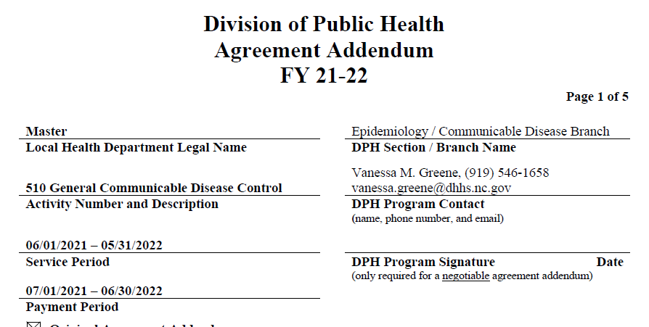
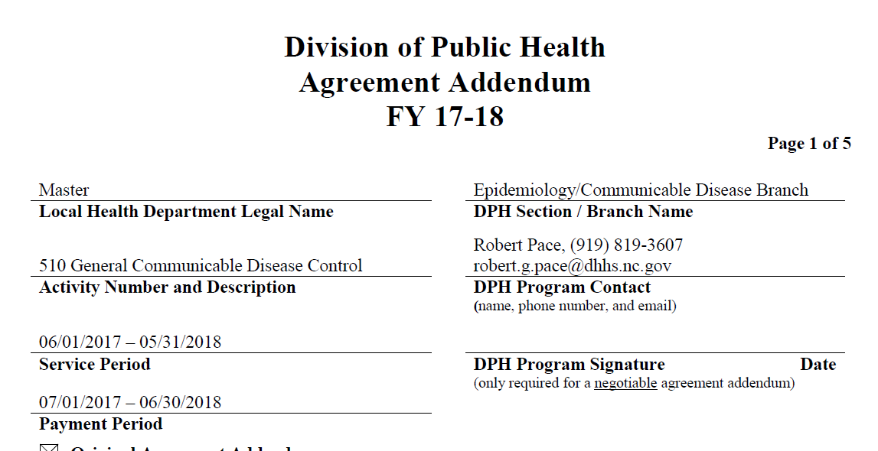

Slide 50
Measure #3

Slide 51
i. All pregnant women are tested for HBsAg during each pregnancy
LHD’s will document this in the mother’s event
If the woman has refused or did not receive prenatal care, document it was done at delivery
If not done at delivery educate hospitals and delivering providers of the ACIP recommendations and NC Law. Document education provided in the event

Slide 52
ii. ) All infants born to HBsAg-positive women and all infants born to women with unknown HBsAg status receive HBIG and a dose of hepatitis B vaccine within 12 hours of birth,
LHD’s receive this information from the delivering hospital’s notes (time of administration should be documented)
If the hospital did not provide this – did the LHD do an investigation/education as to what happened and did they verify policy

Slide 53
iii. all infants born to HBsAg-positive women complete the hepatitis B vaccine series per the most current ACIP recommended schedule,
Routine vaccine schedule: last dose is given 6-18 mos of age, but babies born to Hep B + mothers or unknown status of moms at birth, the last dose must be given at 6 months (Table 3 of current ACIP recs)
The LHD is responsible for ensuring the vaccine is given per ACIP guidelines.
The LHD can delegate it to the PCP, but if the PCP refuses or wants to use a different schedule, the LHD must advise the parents to come to the LHD for proper vaccine schedule
If parents refuse, is it documented; is it documented that the health director was notified and what their decision was

Slide 54
iv. all infants receive timely post-vaccination serology testing according to CDC guidelines?
PVST is only HBsAg and anti-HBs
PVST cannot be done earlier than 9 months
ACIP recommends it be done between 9-12 months of age (ensure 1-2 months after last dose)
If it is parent refusal, is it documented that LHD educated parents and notified the health director

Slide 55
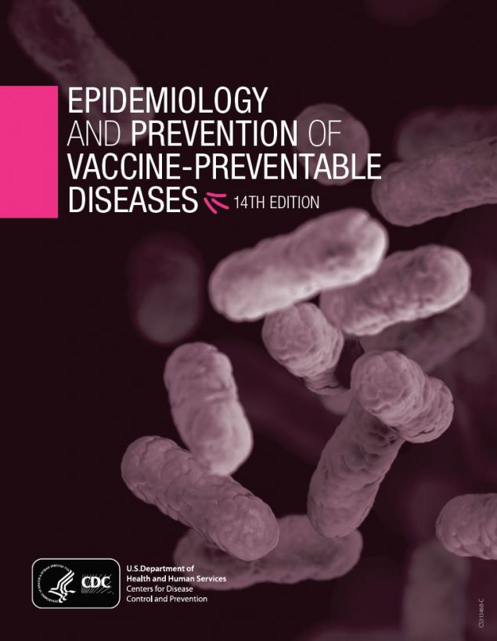
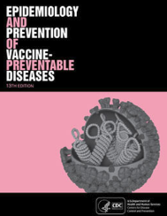
Perinatal Hepatitis B Resources
CDC Perinatal Hepatitis B Website:
https://www.cdc.gov/hepatitis/hbv/perinatalxmtn.htm
Immunization Action Coalition:
http://www.immunize.org/protect-newborns/
http://www.immunize.org/catg.d/p2130.pdf (standing order)
CDC Pink Book – Hepatitis B Chapter
https://www.cdc.gov/vaccines/pubs/pinkbook/hepb.html
Physicians Guide to Hepatitis B: A Silent Killer
https://med.stanford.edu/content/dam/sm/liver/documents/resources/guides/Final_P-Guide_2020_version3.pdf
North Carolina Hepatitis B Public Health Program Manual* http://epi.publichealth.nc.gov/cd/lhds/manuals/hepB/toc.html
Hep B Moms https://www.hepbmoms.org/
Notes:
Hep B Program Manual has been updated but does not include PHB information. We are in process of adding a PHB annex to the Hep B manual.

Slide 56
Resources Cont.
Prevention of hepatitis B Virus Infection in the United States: Recommendations of the Advisory committee on Immunization Practices January 12, 2018
https://www.cdc.gov/mmwr/volumes/67/rr/pdfs/rr6701-H.pdf
Management of Infants Born to Women with hepatitis B Virus Infection for Pediatricians
https://www.cdc.gov/vaccines/programs/perinatal-hepb/downloads/HepB-Provider-tipsheet-508.pdf

Slide 57
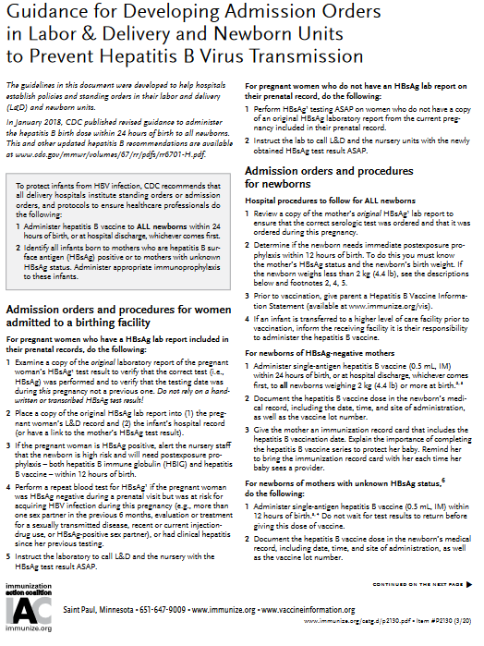
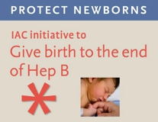
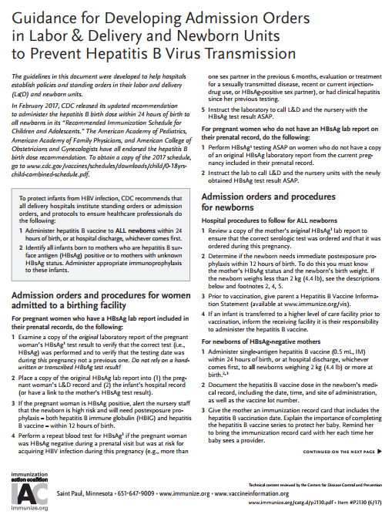
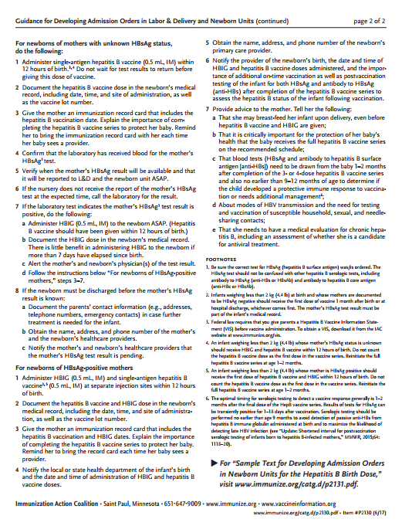
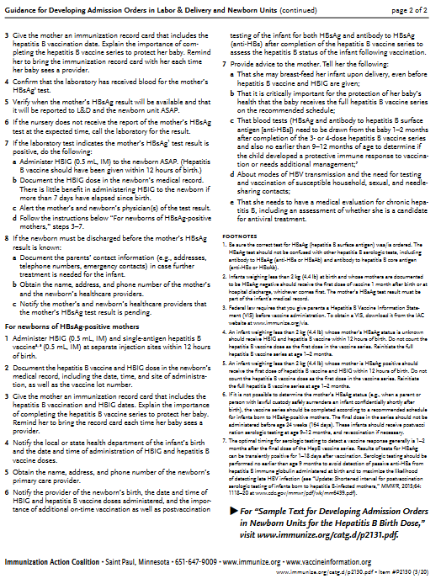
Immunization Action Coalition
www.immunize.org/standing-orders/

Slide 58
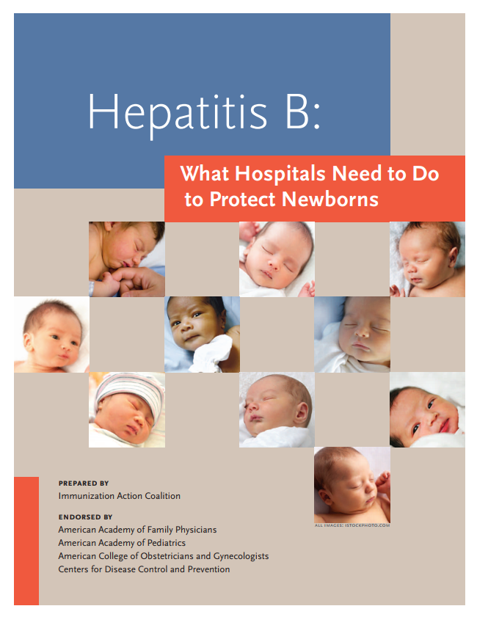
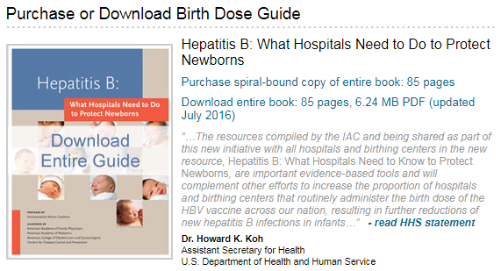
https://www.immunize.org/protect-newborns/guide/

Slide 59
Contact Information
Mary Stanley, RN
Mary.Stanley@dhhs.nc.gov
919-707-5573 (Office)
919-710-6513 (Cell)
Candy Graham, RN
Candy.graham@dhhs.nc.gov
919-270-3857 (Cell)

